Slide 1
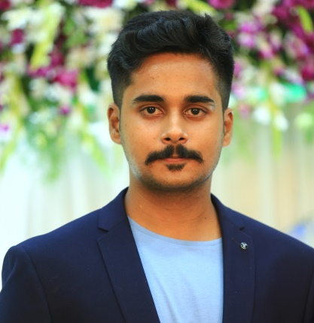

Aliveluvari Sai Vamsi
Analyst/Software Engineer
Bachelor of Technology
Electronics and Communication Engineering: 2018 - 2022
Skills
Core Java
Spring MVC
Spring Core
Spring Boot
Python
NodeJs
MERN Stack
ReactJS
NodeJS
MongoDB
Database
SQL database – SQL,MySQL
No SQL database – MongoDB
Web Technologies
HTML5
CSS3
Javascript
AddOns
Github
Maven
Postman
Additional Details
Leadership
Excellent Communication Skills
Team management
Mumbai
aliveluvari-sai-vamsi.aliveluvari-sai-vamsi@capgemini.com
+91 6303776585
A4
Software Engineer who is Strong in design and integration with intuitive problem-solving skills. Passionate about implementing and launching new projects.
Ready to learn new technologies and implement them to further improve my knowledge.
Eager to work in a team of dedicated people and serve a key role in the enhancement and development of the project.
Hands on experience in creating micro services with Spring boot, Spring Security, Spring Cloud, API Gateway, Eureka server.
Hands on experience in Core Java, NodeJs and other Front-end Technologies.
Certified in AWS Cloud Practitioner and have good knowledge on aws services.
E-Commerce Shopping Cart Application
Completed end to end case study of Shopping Cart Application along using Core Java , Spring Applications, Micro services, Front-end Technologies like HTML, CSS, Javascript ,React and NodeJS
Design of Chat-Bot using Frontend and Backend Technologies
Designed a Chat-Bot along with the webpage where it is used to store the data entered by user and use it for further purpose.
HTML CSS JAVASCRIPT for web developers at Coursera
Completed the course with 92.6% and Designed Shopping cart system and Webpage for Chat-Bot Project.

